Slide 1
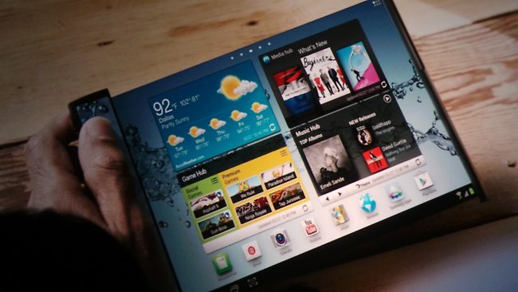
Finch Fx- One

Slide 2
Key Features
Android v5.0 (Lime Pie) OS
Dust-proof, Water Resistant, Scratch Proof
4G (Fourth Generation)
Nano Sim
64 GB Internal Memory and 4 GB RAM
NFC Enabled
41 MP Primary Camera with Auto Focus
Full HD Recording
Wi-Fi and Wi-Fi Hotspot Support
8.2-inch Full HD Display
4.2 GHz Trideca-core Processor
4 Multi Window Facility

Slide 3
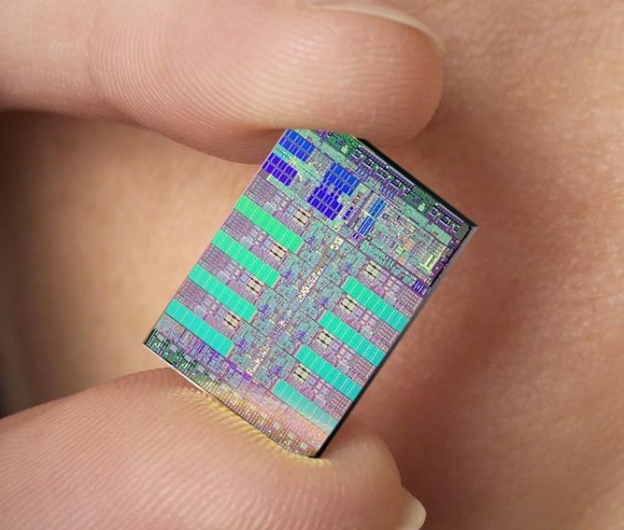
Processor and OS
Single GSM NanoSIM support the smartphone runs on the Android v5.1 (Lime Pie) operating system
It’s fast and simple apart from bringing nifty features like NFC compatibility, bundled notifications, better camera application, easier messaging apart from a fully customizable lock screen and a smoother overall experience.
Supporting the OS is the powerful 4.2GHz Trideca Core processor backed by 4 GB RAM.
Multitasking is a breeze; open multiple apps and perform everyday tasks with ease and a smoothness that is easy to get used to.
The cores are asynchronous which ensures that battery is not wasted and you get power when you actually need it.
The phone also supports pen input and can transform your handwritten notes into text and save them.

Slide 4
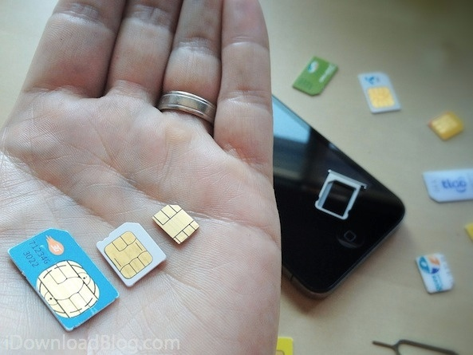
Nano SIM Card
Micro SIM Card
SIM Card
Nano-SIM
On 11 October 2012, mobile service providers began selling the NANOSIM or 4FF (4th form factor) to their mobile users in various countries.
The nano sim measures 12.3 × 8.8 × 0.67 mm and reduces the previous
format to the contact area while maintaining the existing contact arrangements.
The 0.7 mm thickness of the NANOSIM is about 15
percent less than its predecessor.
4FF can be put into adapters for use with devices taking 2FF or 3FF SIMs.

Slide 5
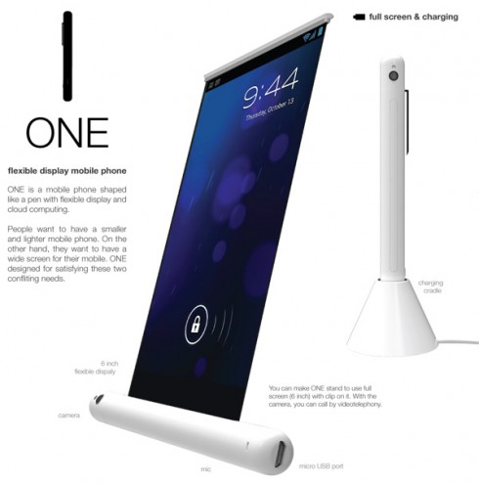
Display
Maximise the life you live with the Finch Fx - One
It comes with a massive 8.2 inch OLED Flexible display with full HD resolution
It ensures that you see images in rich, natural colors. With a massive 642 pixels per inch and without any jagged edges.
The display ensures that the lines between reality and entertainment are blurred all packed into the slimmest of bodies.
Use it in the rain or take it to the pool side without worry about messing it up for the device is built to be waterproof.

Slide 6
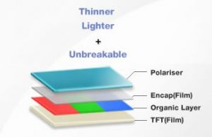
OLED Display
An OLED (organic light-emitting diode) is a LED in which the emissive electroluminescent layer is a film of organic compound which emits light in response to an electric current.
This layer of organic semiconductor is situated between two electrodes.
Generally, at least one of these electrodes is transparent. OLEDs are used to create digital displays in devices such as television screens, computer monitors, portable systems such as mobile phones, handheld games consoles and PDAs.
A major area of research is the development of white OLED devices for use in solid-state lighting applications.
An OLED display works without a backlight. Thus, it can display deep black levels and can be thinner and lighter than a liquid crystal display (LCD).
In low ambient light conditions such as a dark room an OLED screen can achieve a higher contrast ratio than an LCD, whether the LCD uses cold cathode fluorescent lamps or LED backlight.

Slide 7
General Features
Brand - Finch
Model ID - Fx - One
SIM Size - Nano SIM
Platform
Android v5.0 (Lime Pie)
Trideca Core Processor
Display
Size - 8.2 Inches
Other Display Features - Scratch Resistant Glass, OLED Display, Gesture Input, 10 Fingers Multi-touch Supported, Dust-proof and Water-resistant, Colour and Contrast Enhancement, Pen Input with Stylus

Slide 8
Memory and Storage
Internal - 64 GB
Expandable Memory - microSD, upto 128 GB
Memory - 2 GB RAM
Other Features
Sensors - Accelerometer, Proximity Sensor, eCompass, Magnetometer, Gyroscope, Ambient Light Sensor
Additional Features
SensMe, One-touch (Sharing, Listening, Mirroring, Backup), Open Authentication, Shared Authentication, Media Transfer Protocol Support, Google Voice Search, Face Unlock, STAMINA Mode, Throw, Senser-on-lens, Call List, Screen Mirroring, Wi-Fi Direct, Wi-Fi Protected Setup, TV Launcher, Reader Mode, Handwriting Recognition, MMS Enabled, Sound Recorder, Predictive Text Input, Motion Gaming, Audio and Video Streaming, Screenshot Capturing, 3D Games, Auto Rotation, ANT+, NeoReader Barcode Scanner, Multi-task, Pan and Zoom, NFC Support, Firmware Upgrade, TrackID Music Recognition, Voice Input
Important Apps - Google Play, Google Search, Facebook, Google Talk, Twitter, Gmail, YouTube, Instant Messaging, Bookmarks, Twitter

Slide 9
Finch
Today’s Thinking
Tomorrow Possibilities

